Slide 1

NorthStar
Project Purpose:
A head mounted visual assist system for the visually impaired.
Goals:
To assist the visually impaired in navigating the real world in an easier and more comfortable manner.
Notes:
Good afternoon, everyone. We are excited to present NorthStar, our Senior Design project.
NorthStar is a head-mounted visual assist system specifically designed to empower individuals with visual impairments. Our primary objective is to bridge the gap between technology and accessibility by providing a tool that helps users navigate their physical environments with greater ease, safety, and confidence.
Today, we will take you through our project milestones, the design architecture we’ve developed, and the progress we’ve made in bringing this assistive technology to life.

Slide 2
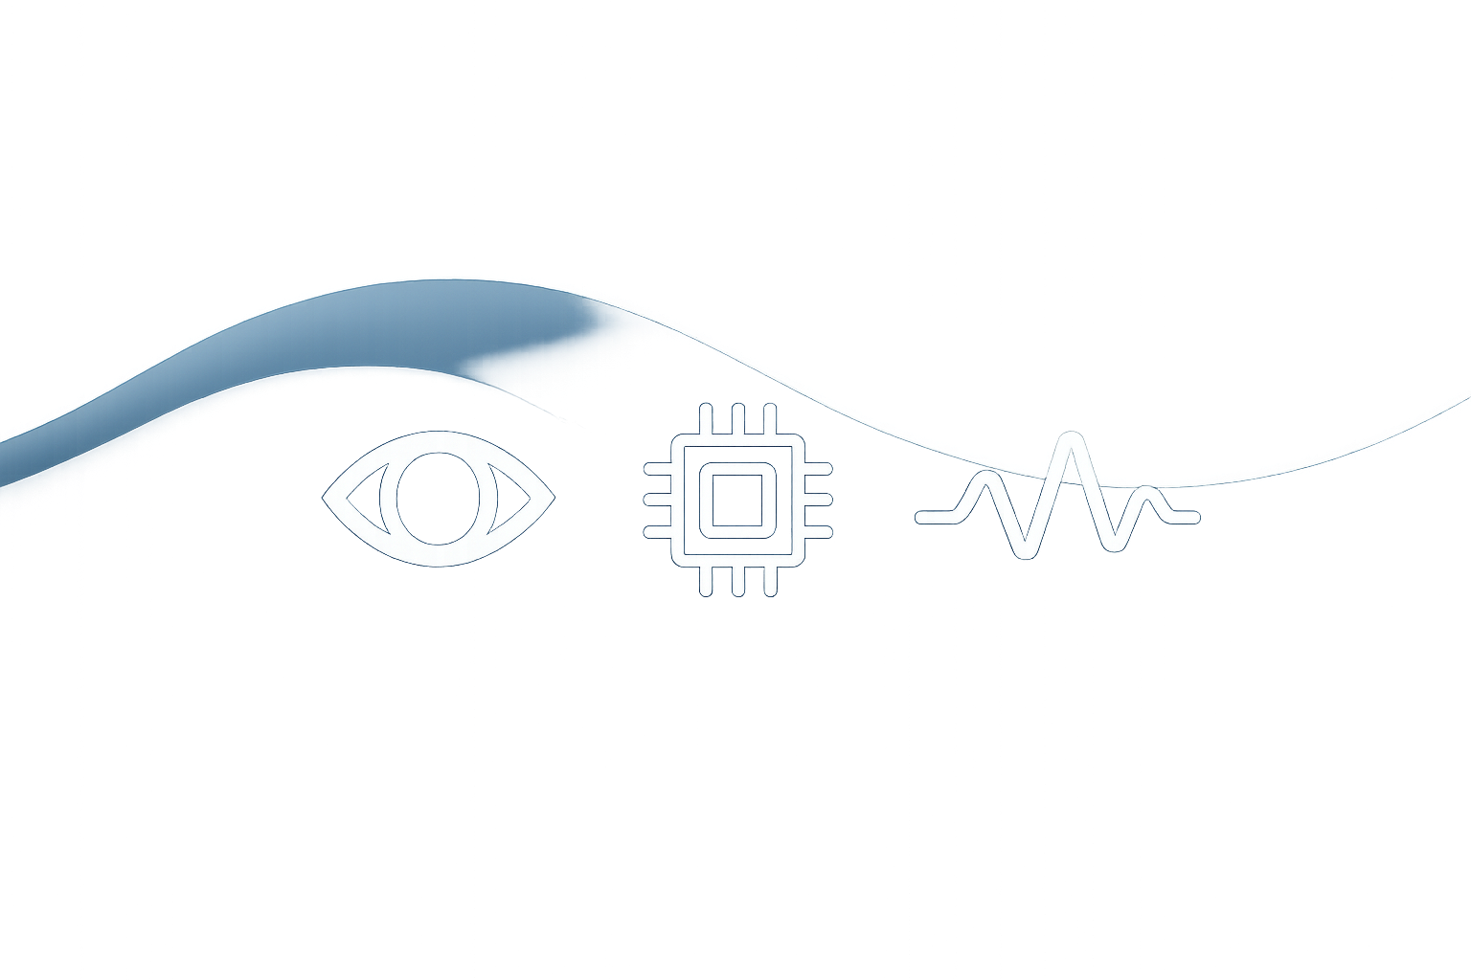
Project Abstract
A head-mounted visual assist system designed to support visually impaired users.
Captures environmental data through vision and AI-based object detection and recognition features.
Retrieves context from a trained database of objects and user related data, generating personalized audio feedback through a text-to-speech module.
Northstar transforms visual information into auditory cues, empowering users to navigate and interact more safely and independently within their surroundings.
Notes:
Here is a high-level abstract of our system. As mentioned, NorthStar is a head-mounted unit designed to serve as a comprehensive visual assistant.
The system works by capturing real-time environmental data using integrated cameras and sensors. We leverage AI-based object detection and computer vision to process this visual input as the user moves through their environment.
This raw data is then cross-referenced with a trained database to extract contextual meaning. The system translates this information into personalized audio feedback via a text-to-speech module, effectively alerting the user to hazards or important details in their vicinity.
In summary, by synthesizing AI, computer vision, and assistive audio, NorthStar transforms complex visual information into clear auditory cues, enabling users to navigate their surroundings with significantly increased safety and independence.

Slide 3

Team members and advisor
Christian Graber
Mohamed Elmogaber
Jared Walden
Viet Ton
Badri Vellambi (Advisor)
Notes:
The team dedicated to bringing NorthStar to reality consists of four members.
I am Christian Graber, and I am joined by my colleagues Mohamed Elmogaber, Jared Walden, and Viet Ton.
We are also privileged to be working under the guidance of our faculty advisor, Professor Badri Vellambi, whose support has been instrumental in the development of this project.

Slide 4
Project Constraints
Economic Factors
Relies on affordable hardware like a Raspberry Pi and open-source software.
Ethical and Security Constraints
Ensure user privacy by using secure standards.
Technical Complexity
The latency of this integrated system is a critical factor.

Slide 5
Review of Project Progress
RAG Model
OCR Model
Object Detection
Notes:
Moving on to our current status, we have made significant strides in laying the groundwork for NorthStar.
First, we have formally defined our project proposals and goals. This step was critical to ensure the entire team is aligned on the scope of the project and the specific accessibility problems we aim to solve.
Second, we have completed in-depth research for our respective responsibilities. Each team member has deep-dived into their specific technical domain—whether that is computer vision, audio processing, or hardware integration—to validate that our design choices are feasible.
Finally, we have transitioned from research to logistics. We have created a comprehensive list of tools and hardware required for the build. Our Bill of Materials is finalized, positioning us to begin the procurement and prototyping phase immediately.

Slide 6
Thank You!
Notes:
Thank You.

